Slide 1
PB‑FUSE NAS E2E using Raspberry Pi 5
Manuel Alvarado
Caleb Jala-Guinto
Isabel Warth

Slide 2
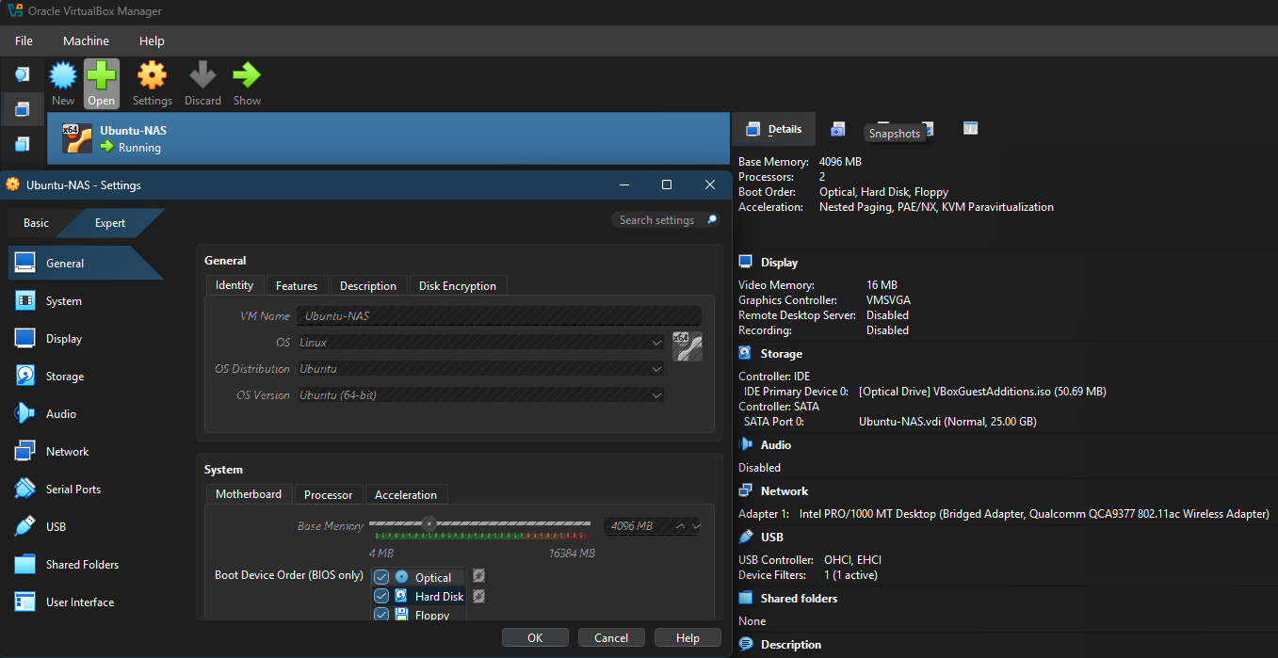
Project Overview
A secure Ubuntu-based NAS server (running NFS), with a custom PB-FUSE filesystem on the Raspberry Pi 5.
Uses a hashing pipeline with PhotonBeetle to identify, deduplicate, and store blocks, forming a complete end-to-end system that supports:
-File writes
-File reads
-Deduplication
-Metadata tracking on the client side
-Network-backed storage

Slide 3
Project Overview
A Virtual NAS with Enhanced Content-Aware Storage:
Our project implements a network-attached storage system that behaves like a normal NAS but stores files in a deduplicated, block-based, encrypted form.
The Raspberry Pi–based PB-FUSE filesystem breaks files into chunks, encrypts them with a modified PhotonBeetle, and stores only unique blocks. Improvements over standard PhotonBeetle include:
- SIV mode for nonce-misuse resistance.
- Dual-tag authentication for tamper/fault detection.
- KeyID headers for early key mismatch rejection.
- Optional Merkle-tree verification for integrity and rollback protection.
All metadata and integrity checks are handled on the client, so the NAS only sees encrypted blocks. The result is a space-efficient, secure NAS that preserves deduplication while hardening PhotonBeetle against known vulnerabilities.

Slide 4
High-Level Architecture
+------------------------------------+ +------------------------------------+ +------------------------------------+ +------------------------------------+
| User Clients (Windows) | → | PB-FUSE Client / VM | → | Metadata DB | → | TrueNAS Storage |
| - Access NAS via SMB | | - Handles PB-FUSE ops | | - Block index tables | | - ZFS-backed dataset |
| - Can mount PB-FUSE FS | | - Parses file operations | | - File → block mapping | | - Stores actual files |
| - Send read/write requests | | - Communicates w/ Redis | | - Validates access/locks | | - Redundant snapshots |
+------------------------------------+ +------------------------------------+ +------------------------------------+ +------------------------------------+
| | |
|1. File ops → metadata lookups | 2. Block existence check | 3. Block read/write to dataset
| | |
v v v
(PhotonBeetle optional) (AUTH + protected-mode enabled) (SMB/NFS backend I/O)
Data Flow Summary:
User interacts with the FUSE mount on the Raspberry Pi.
PB-FUSE splits files into blocks and hashes each block using PhotonBeetle.
PB-FUSE checks its local metadata to see if the block already exists.
If the block is new: it is stored on the VM NAS.
If the block is a duplicate: PB-FUSE re-uses the existing block.
Local metadata on the Pi is updated to map files to their constituent blocks.
For reads: PB-FUSE consults the local metadata → retrieves blocks from the NAS → reconstructs the file.

Slide 5
Conclusion
✔ A working content-addressed filesystem
✔ Using PhotonBeetle hashing
✔ Backed by a functional Ubuntu NAS
✔ Metadata tracked locally on the Pi for file → block mapping
✔ Supports deduplication and file reconstruction

